Slide 1
Chapter 22 JavaFX Graphics and Multimedia

Slide 2
Objectives
In this chapter you’ll:
Use JavaFX graphics and multimedia capabilities to make your apps “come alive” with graphics, animations, audio and video.
Use external Cascading Style Sheets to customize the look of Nodes while maintaining their functionality.
Customize fonts attributes such as font family, size and style.
Display two-dimensional shape nodes of types Line, Rectangle, Circle, Ellipse, Arc, Path, Polyline and Polygon.
Customize the stroke and fill of shapes with solid colors, images and gradients.
Use Transforms to reposition and reorient nodes.
Display and control video playback with Media, MediaPlayer and
MediaView.
Animate Node properties with Transition and Timeline animations.
Use an AnimationTimer to create frame-by-frame animations.
Draw graphics on a Canvas node.
Display 3D shapes.

Slide 3
22.1 Introduction
In this chapter, we continue our discussion of JavaFX from Chapters 12 and 13.

Slide 4
22.2 Controlling Fonts with Cascading Style Sheets (CSS)
Place CSS rules that specify the font properties, spacing and padding in a separate file that ends with the .css filename extension, then reference that file from the FXML.
Each CSS rule begins with a CSS selector which specifies the JavaFX objects that will be styled according to the rule.

Slide 5
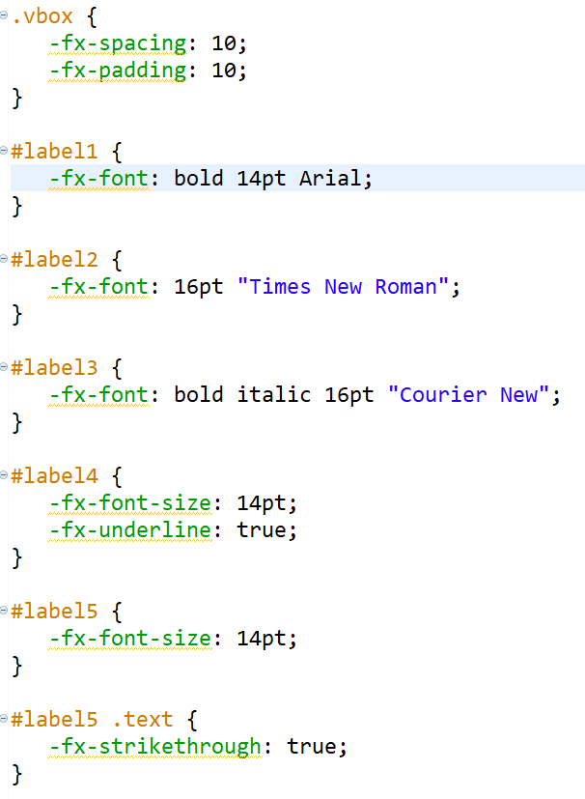
a style class selector begins with a dot (.) and is followed by its class name
Each JavaFX CSS property name begins with -fx-1 followed by the name of the corresponding JavaFX object’s property in all lowercase letters.
Selectors that begin with # are known as ID selectors—they are applied to objects with the specified ID.
The selector in this case is a combination of an ID selector and a style class selector.
first locates the object with the ID label5, then within that object looks for a nested object that specifies the class text.

Slide 6
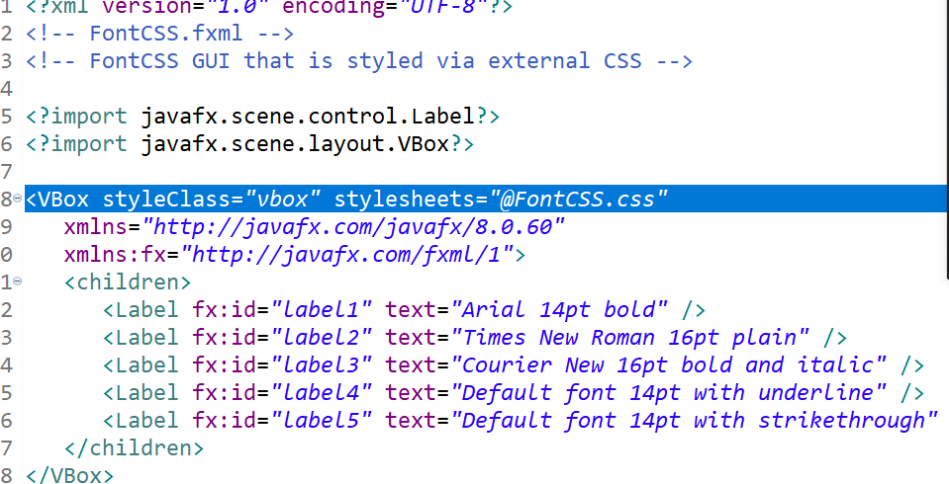
XML declaration
comments
FXML import declarations
One root element
XML namespaces

Slide 7
22.2 Controlling Fonts with Cascading Style Sheets(cont.)
Referencing the CSS File from FXML
1. Select the VBox in the Scene Builder.
2. In the Properties inspector, click the button under the Stylesheets heading.
3. In the dialog that appears, select the FontCSS.css file and click Open.

Slide 8
22.2 Controlling Fonts with Cascading Style Sheets(cont.)
Programmatically Loading CSS
scene.getStylesheets().add(getClass().getResource("FontCSS.css").toExternalForm());
String java.net.URL.toExternalForm()
Constructs a string representation of this URL.

Slide 9
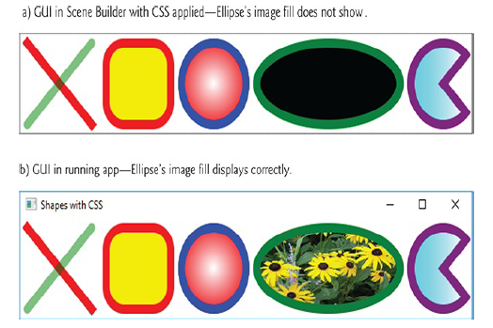
22.3 Displaying Two-Dimensional Shapes

Slide 10
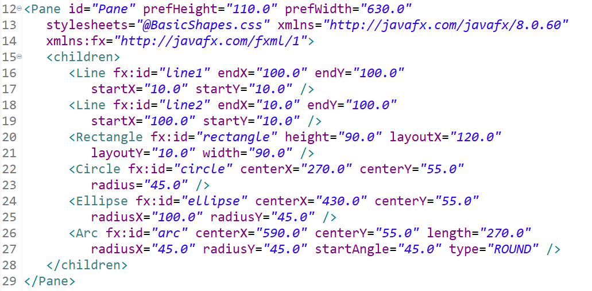

Slide 11
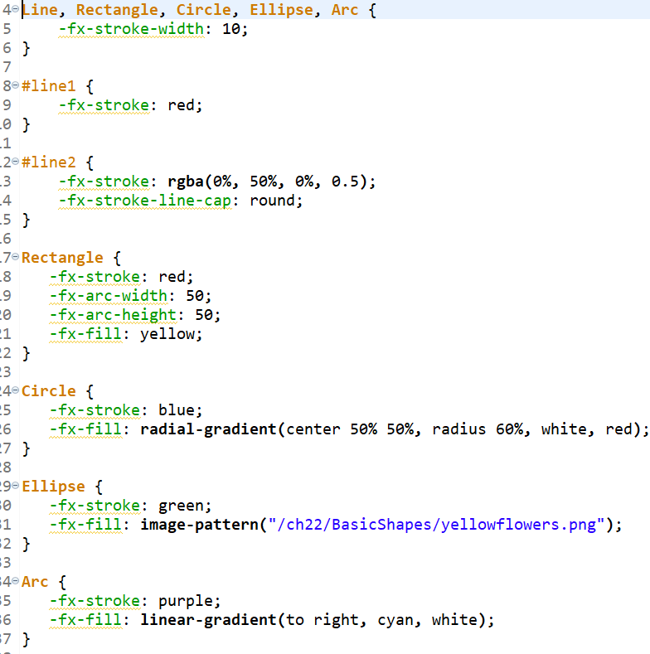
indicates that the rule in lines 4–6 should be applied to all objects of types Line,
Rectangle, Circle, Ellipse and Arc in the GUI.
indicates that the gradient should begin from a center point at 50% 50%
This radial gradient begins with the color white in the center and ends with red at the outer edge of the Circle’s fill.
transition from one
color to the next horizontally, vertically or diagonally.

Slide 12
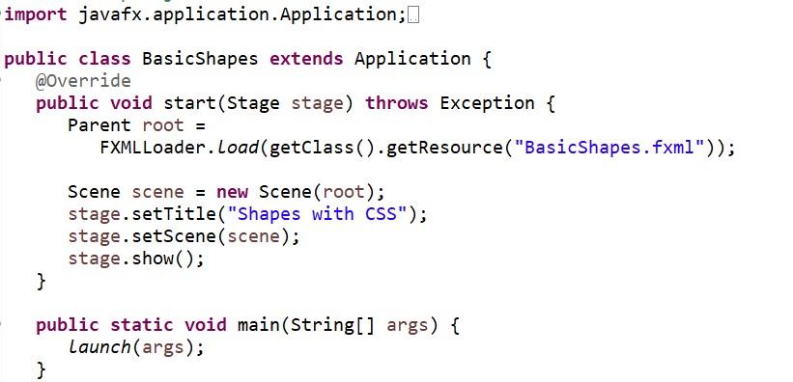

Slide 13
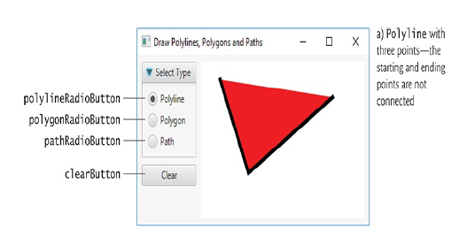
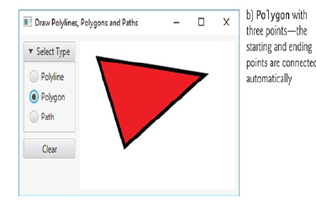
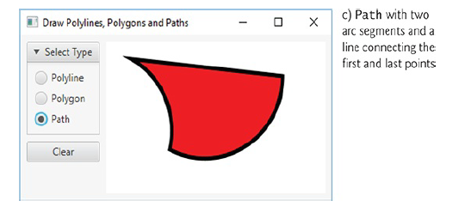
22.4 Polylines, Polygons and Paths

Slide 14
Example PolyShapes
PolyShape.css
PolyShapes.fxml
PolyShapes.java
PolyShapesController.java

Slide 15
22.4 Polylines, Polygons and Paths(cont.)
Method initialize
setUserData： associate any Object with each JavaFX control
Method drawingAreaMouseClicked
MoveTo—Moves to a specific position without drawing anything.
ArcTo—Draws an arc from the previous PathElement’s endpoint to the specified location. We’ll discuss this in more detail momentarily.
ClosePath—Closes the path by drawing a straight line from the end point of the last PathElement to the start point of the first PathElement

Slide 16
22.5 Transforms
A transform can be applied to any UI element to reposition or reorient the element.
The built-in JavaFX transforms are subclasses of Transform. Some of these subclasses include:
Translate—moves an object to a new location.
Rotate—rotates an object around a point and by a specified rotation angle.
Scale—scales an object’s size by the specified amounts.

Slide 17
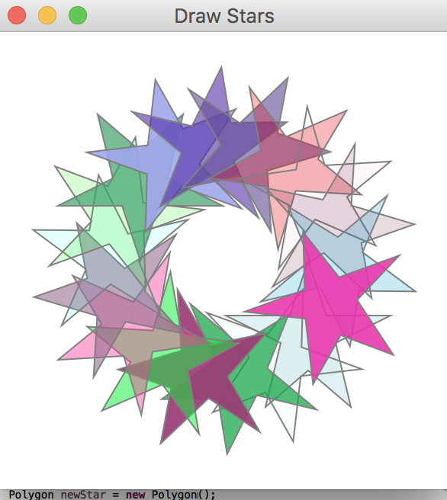

Slide 18
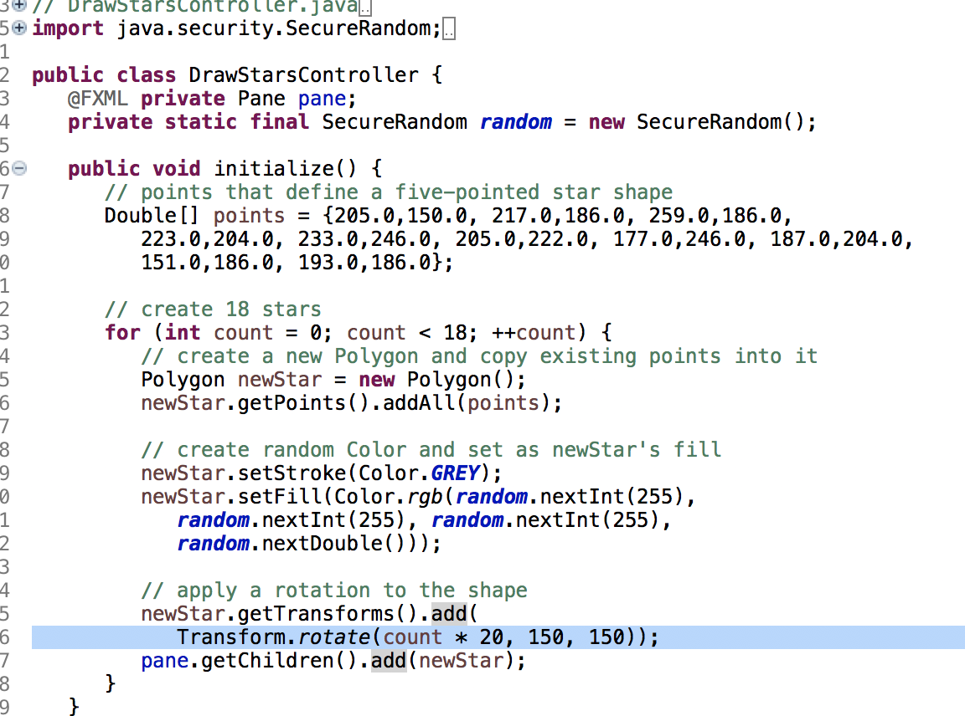

Slide 19
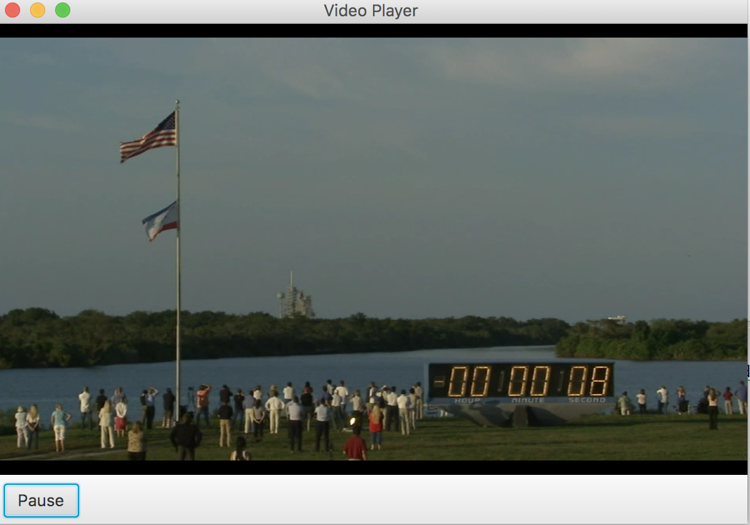
22.6 Playing Video with Media, MediaPlayer and MediaViewer

Slide 20
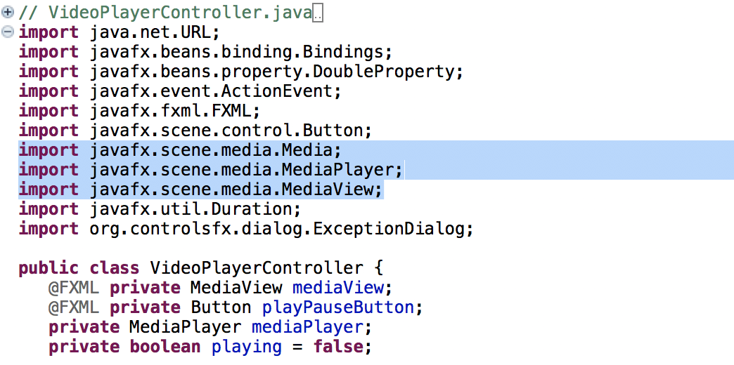

Slide 21
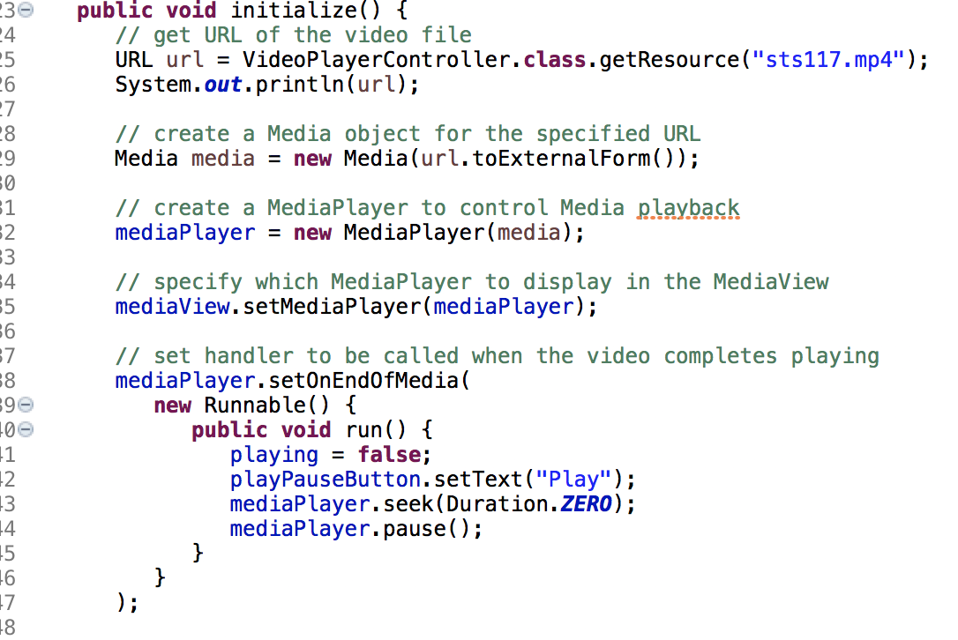

Slide 22
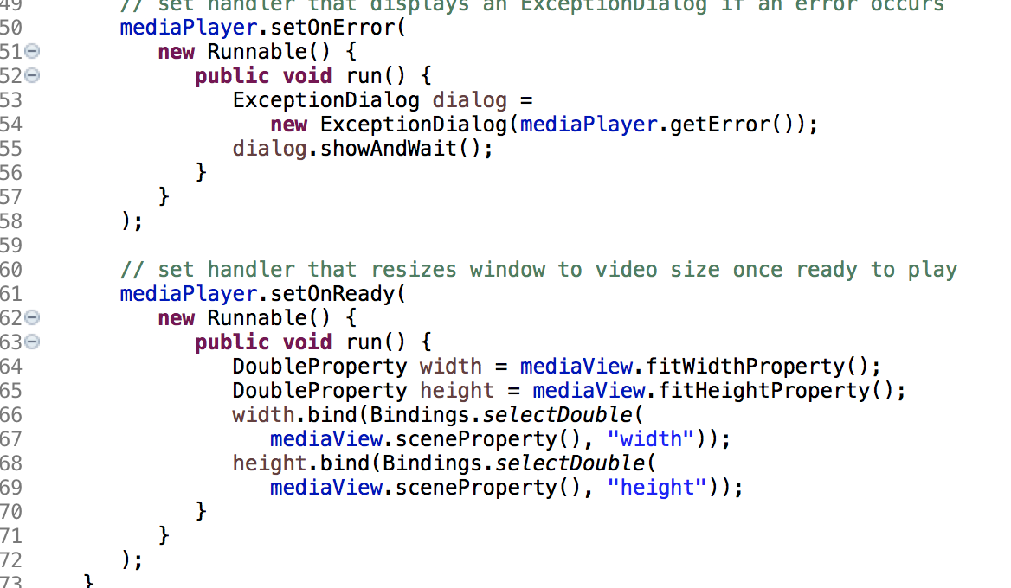

Slide 23
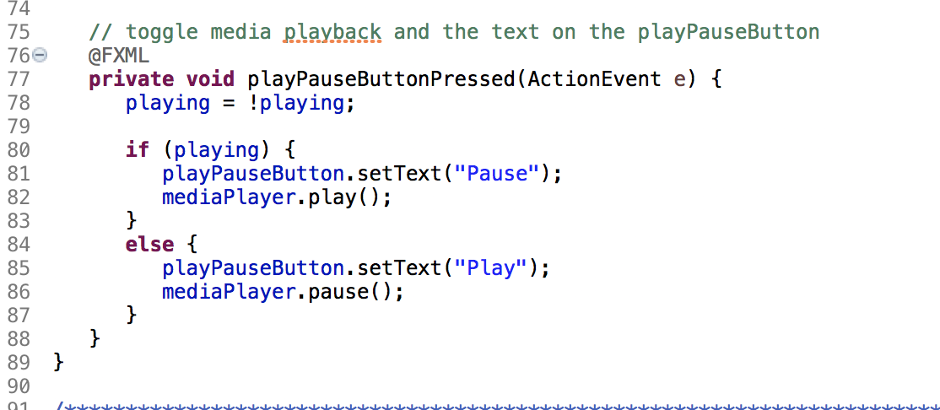

Slide 24
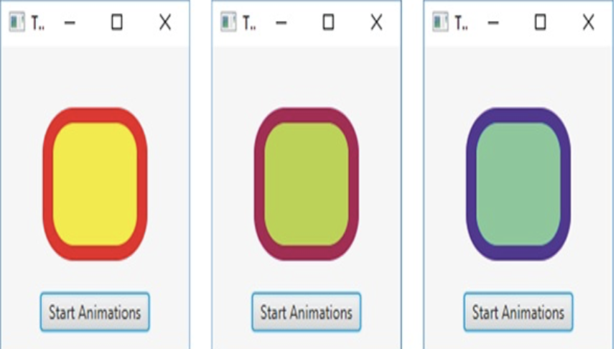
22.7 Transition Animations

Slide 25
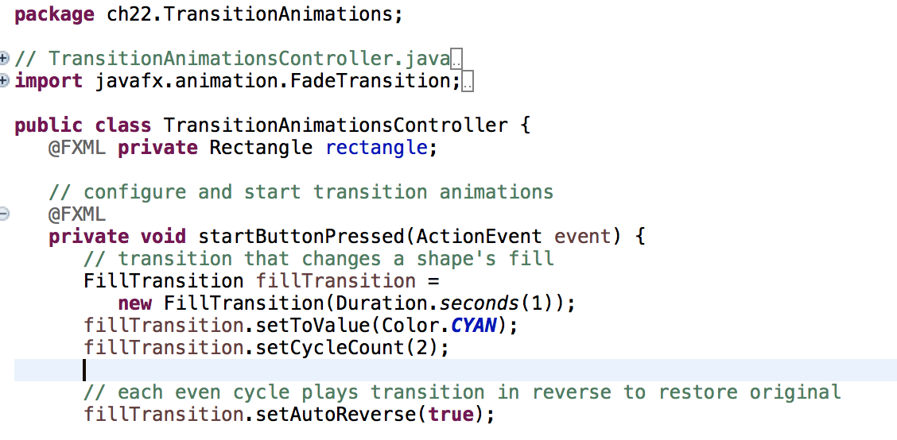
For this animation, during the first cycle the fill color changes from the original fill color to CYAN, and during the second cycle the animation transitions back to the original fill color.

Slide 26
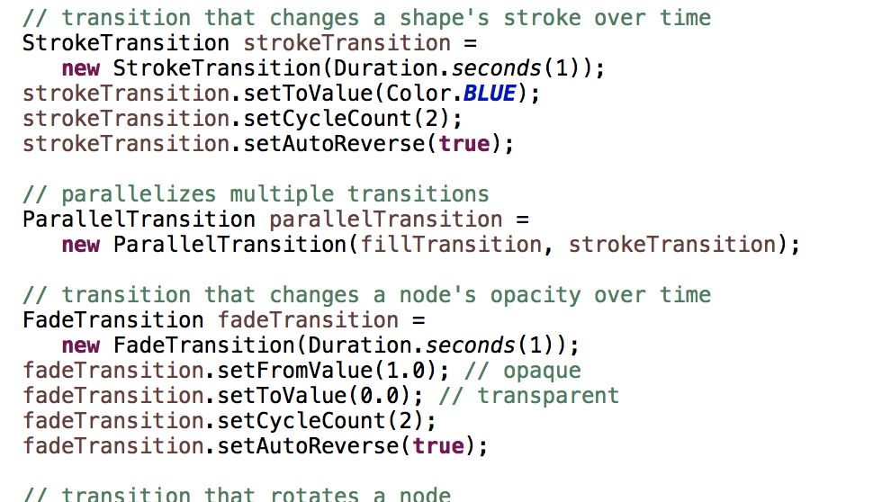
For this animation, during the first cycle the stroke color changes from the original stroke color to BLUE, and during the second cycle the animation transitions back to the original stroke color.

Slide 27
In this case, the FillTransition and StrokeTransition will be performed in parallel on the app’s Rectangle.
This Transition creates a fade effect(渐变) animation that spans its duration.

Slide 28
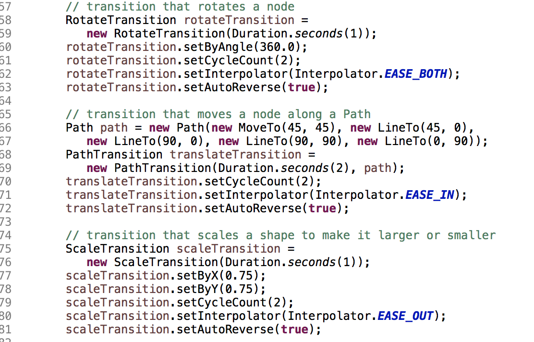
Interpolator EASE_BOTH, which changes the rotation slowly at first (known as “easing in”), speeds up the rotation in the middle of the animation, then slows the rotation again to complete the animation

Slide 29
Lines 55–72 configure a two-second PathTransition that changes a shape’s position by moving it along a Path.
Lines 74–81 configure a one-second ScaleTransition that changes a Node’s size.

Slide 30
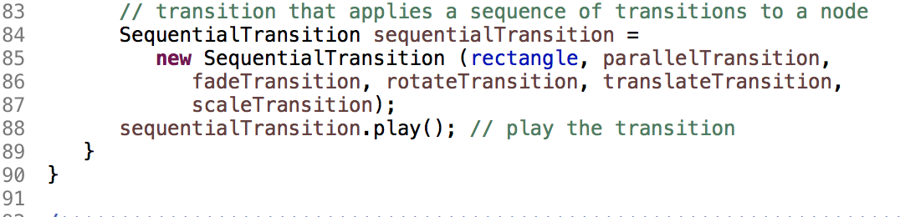
Lines 83–88 configure a SequentialTransition that performs a sequence of transitions—as each completes, the next one in the sequence begins executing.

Slide 31
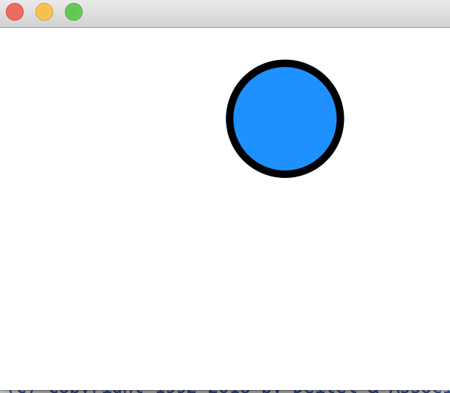
22.8 Timeline Animations

Slide 32
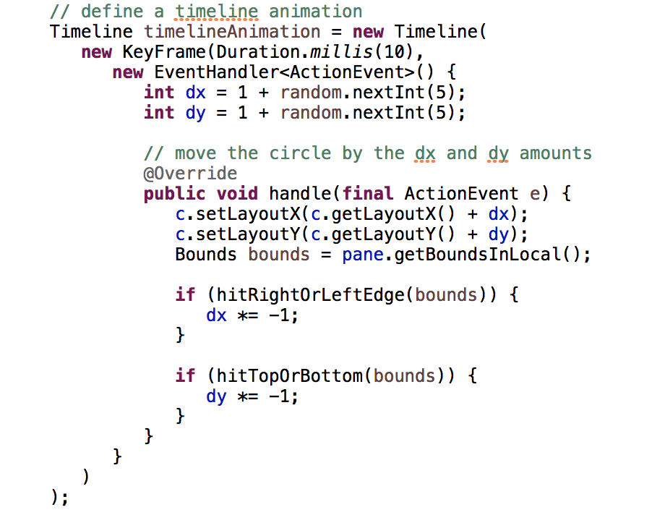

Slide 33
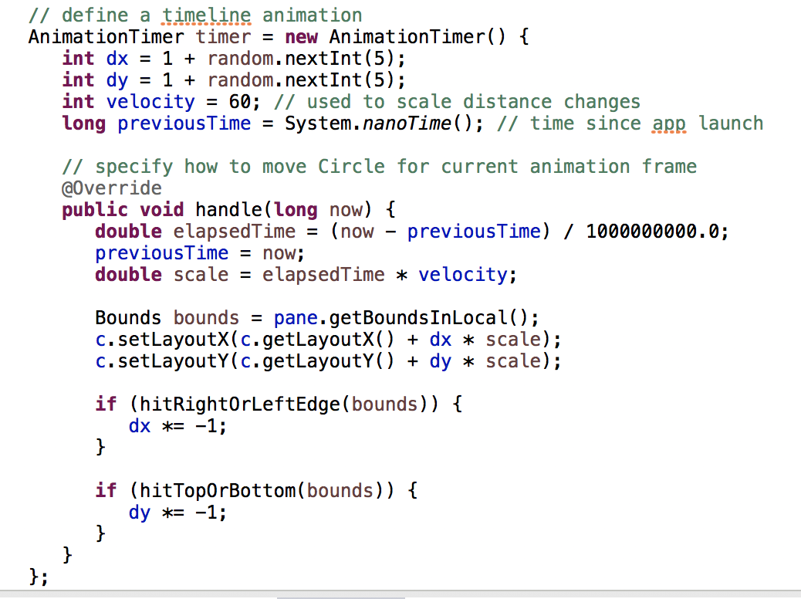
22.9 Frame-by-Frame Animation with AnimationTimer

Slide 34
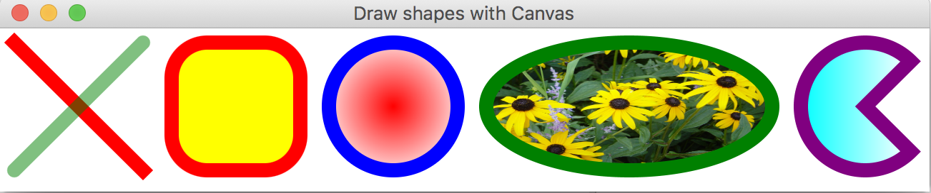
22.10 Drawing on a Canvas

Slide 35
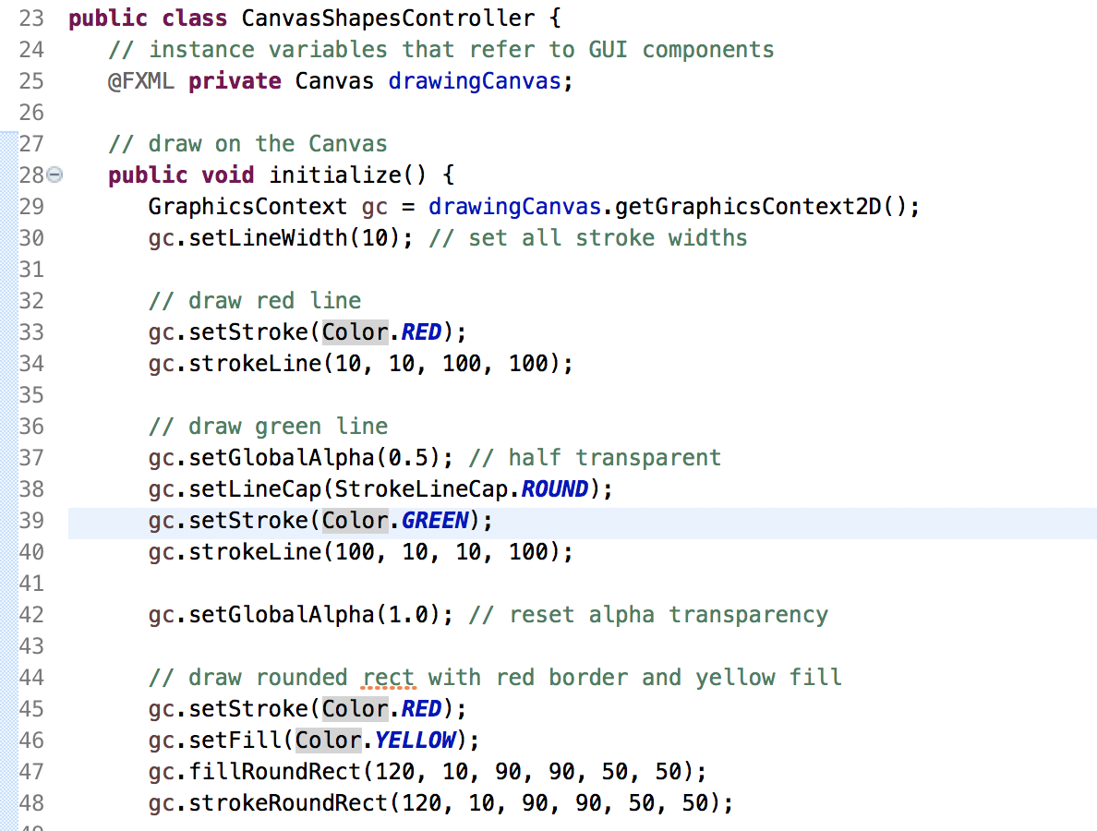



Slide 36
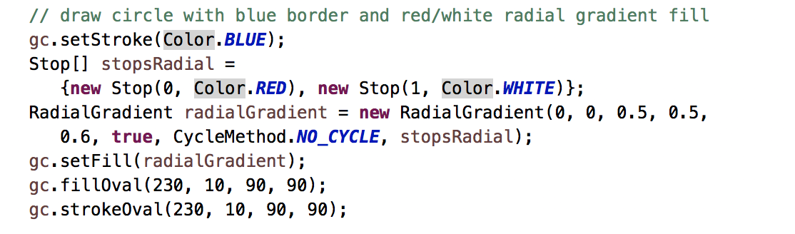
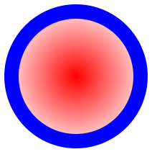

Slide 37
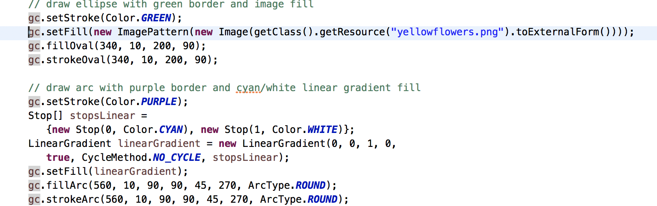


Slide 38
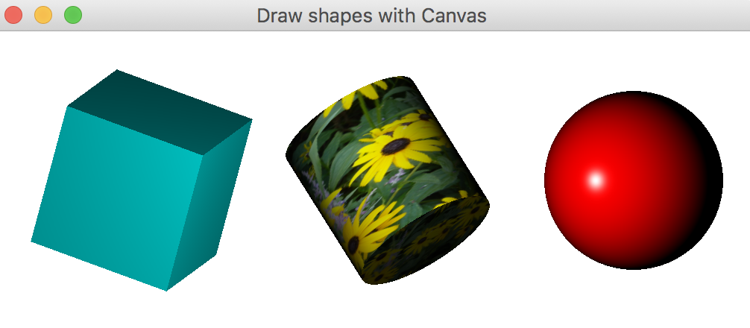
22.11 Three-Dimensional Shapes

Slide 39
22.11 Three-Dimensional Shapes(cont.)
Box Properties
Set Width, Height and Depth to 100
Set Layout X and Layout Y to 100 to specify the location of the cube.
Set Rotate to 30 to specify the rotation angle in degrees. Positive values rotate counter-clockwise.
For Rotation Axis, set the X, Y and Z values to 1 to indicate that the Rotate angle should be used to rotate the cube 30 degrees around each axis.

Slide 40
22.11 Three-Dimensional Shapes(cont.)
Cylinder Properties
Set Height to 100.0 and Radius to 50.
Set Layout X and Layout Y to 265 and 100, respectively.
Set Rotate to -45 to specify the rotation angle in degrees. Negative values rotate clockwise.
For Rotation Axis, set the X, Y and Z values to 1 to indicate that the Rotate angle should be applied to all three axes.

Slide 41
22.11 Three-Dimensional Shapes(cont.)
Sphere Properties
Set Radius to 60.
Set Layout X and Layout Y to 430 and 100, respectively.

Slide 42
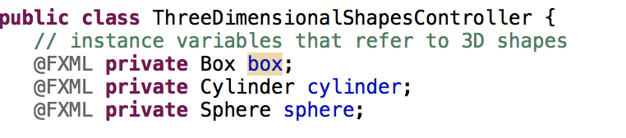
three-dimensional shapes

Slide 43
